Slide 1

Team Electro
Hydroponics System

Slide 2
Introduction
Today, we're delving into the exciting world of electronics within a hydroponics system, but with a twist tailored just for our young friends from Spa Park primary School.
We're here to introduce you to the wonders of sustainable agriculture technologies.
Goal: Our mission? To create not just any system, but a reliable, user-friendly educational tool, sparking curiosity and learning at every turn. Let's sow the seeds of knowledge together!

Slide 3
Team Roles
Armend: All sensor and Arduino related code
Chay: Node – Red functionality and sensor/Arduino code
Felix: Node – Red functionality and sensor/Arduino code
Michael: CAD modeling & component mounting
Ryan: Wiring of sensors and educational toolkit
Taryn: Educational Documentation and wiring diagram

Slide 4
Stakeholder Overview and Needs
Engineering students (primary stakeholder) :
Needs: Hands-on design experience, academic recognition.
Values: Innovation, practical skills application.
Primary School Teachers & Students (secondary stakeholder):
Needs: Educational content, easy-to-use system.
Values: Learning, engagement in STEM.
Local Community & Parents (tertiary stakeholder):
Needs: Improved educational resources, community engagement.
Values: Sustainability, educational advancement.
Professors (secondary stakeholder):
Needs: Successful teaching outcomes, student learning growth.
Values: Academic rigor, educational innovation.

Slide 5
Stakeholder | Description | Level of Involvement | Motivations (Gain/Loss)
Engineering Students | The students at PSU and BC working on the project | Primary | Grades, design project experience, making a difference or impact on the primary school students
Primary School Students | The students at Spa Park primary who will be learning from the Hydroponics system | Primary | Learning about hydroponics, experience interacting with university students, gaining motivation to follow dreams.
Teachers | The teachers at Spa Park Primary will be educating students on the system. | Primary | Successful integration into curriculum, interesting material to teach students, students excited to learn about materials
Professors | The professors from PSU and BC who oversee the class | Secondary | Creating a conducive environment to learning, allowing students to work through challenges
Local Community | The community of Bela-Bela who will ultimately benefit from learning more about hydroponics | Tertiary | Learn about the power of hydroponics to implement the same in other schools, promote the ideas of continued education and hard work
Parents/guardians | The guardians of the children at spa park, they are responsible for influencing and supporting their children's education | Tertiary | They might see an improvement in their children's interest in science and agriculture

Slide 6
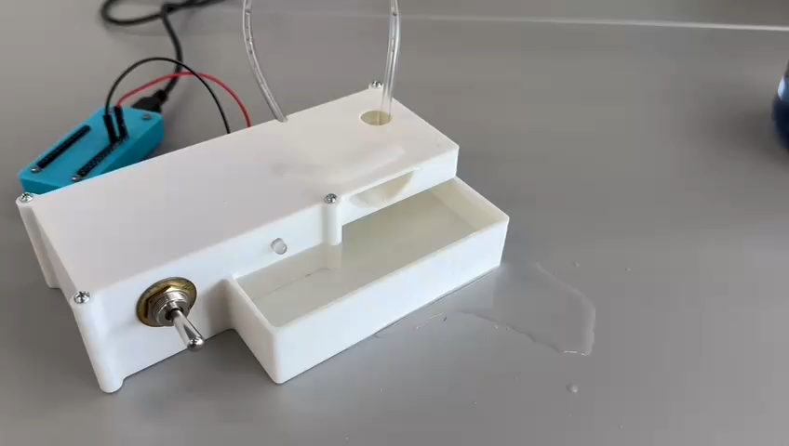
Design Metrics to meet Stakeholder Needs
Educational Impact:
Successfully created a simple educational kit to demonstrate electricity with a flip of a switch
Hands on learning experience
Keeping Within Budget:
Did not exceed the dedicated budget of $250
Accuracy and Reliability:
Sufficient code with error handling
Design meets criteria to be considered reliable overall
Temperature Sensor:
Accurate data measured and sent successfully to dashboard in expected time
Water Level Sensor:
Accurate data measured and sent successfully to dashboard in expected time
TDS Sensor:
Successfully got TDS sensor to measure and send accurate data to the dashboard in expected time
Efficient Use of Power:
Able to keep below 150W of power for a sufficient system
Data Logging:
Data logged on dashboard faster than what was aimed for
Data updates every 3 seconds

Slide 7
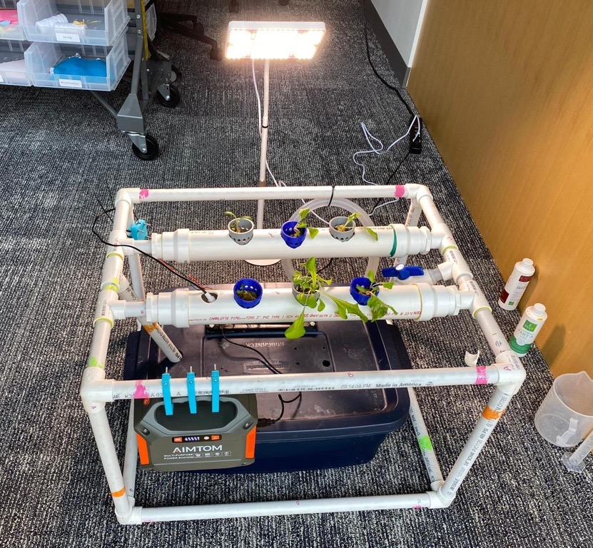
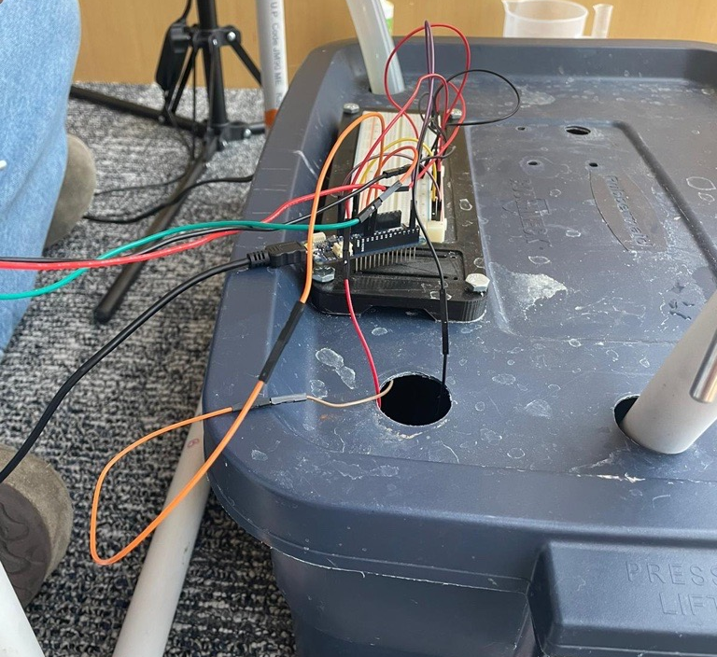
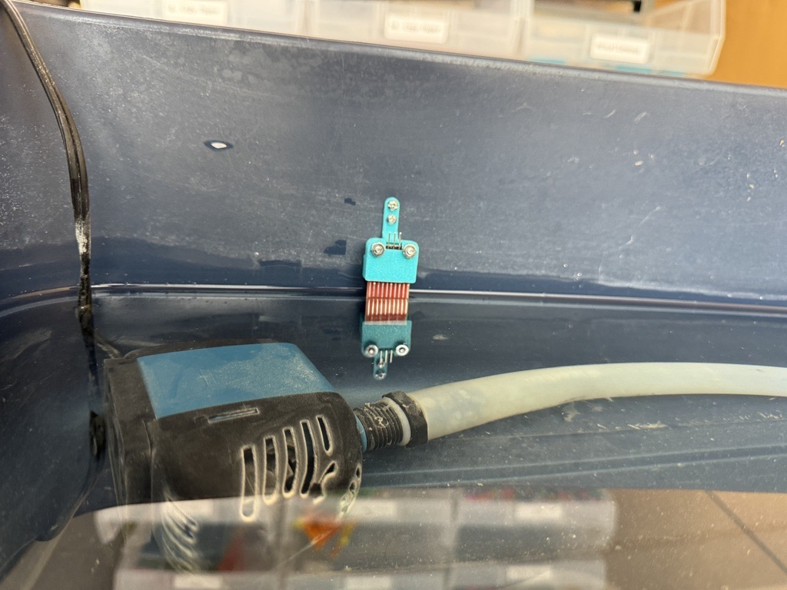
Final Design Overview
Front view showing battery, temperature, & TDS sensor mounting on frame
Arduino & Breadboard mounted on lid of water reservoir box
Water Level Sensor positioned in reservoir

Slide 8
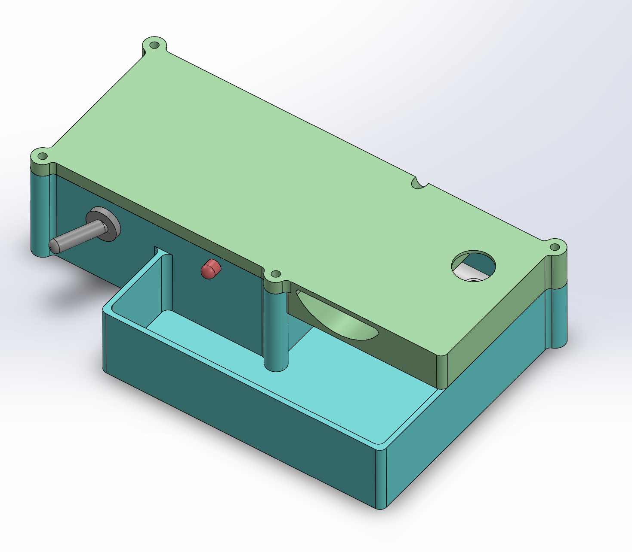
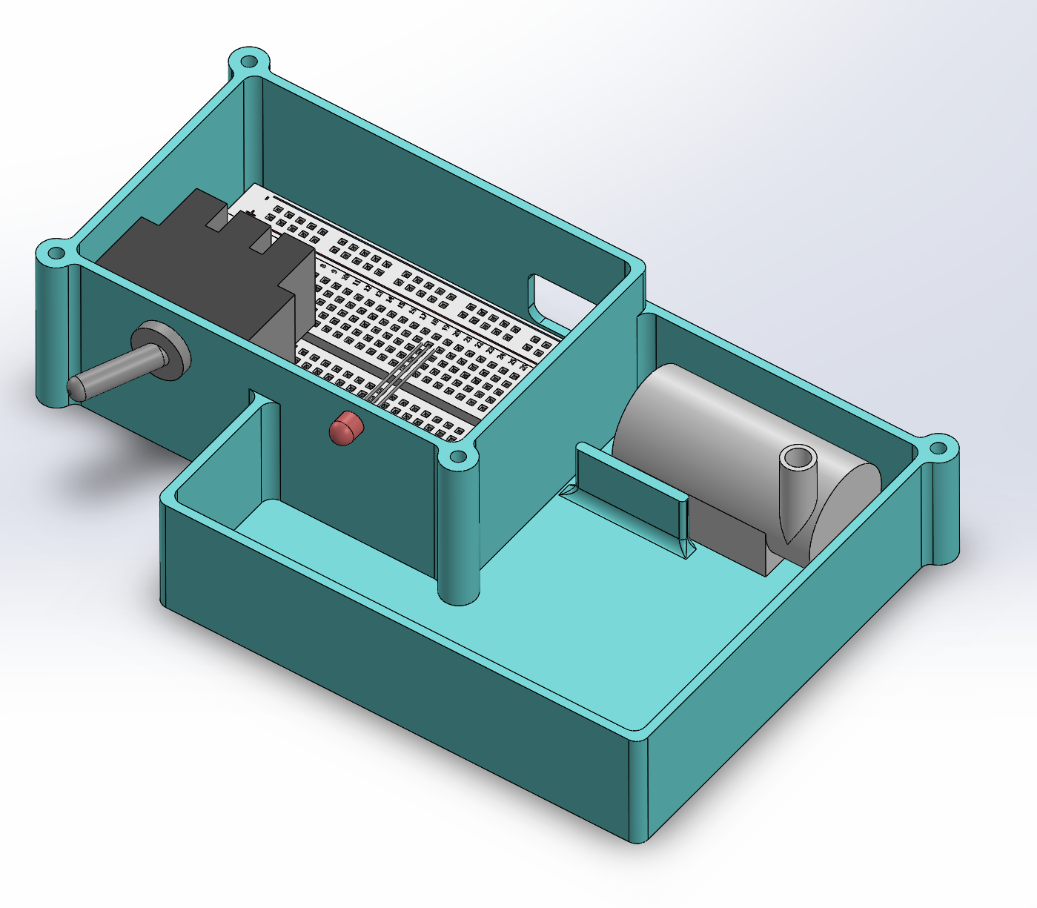
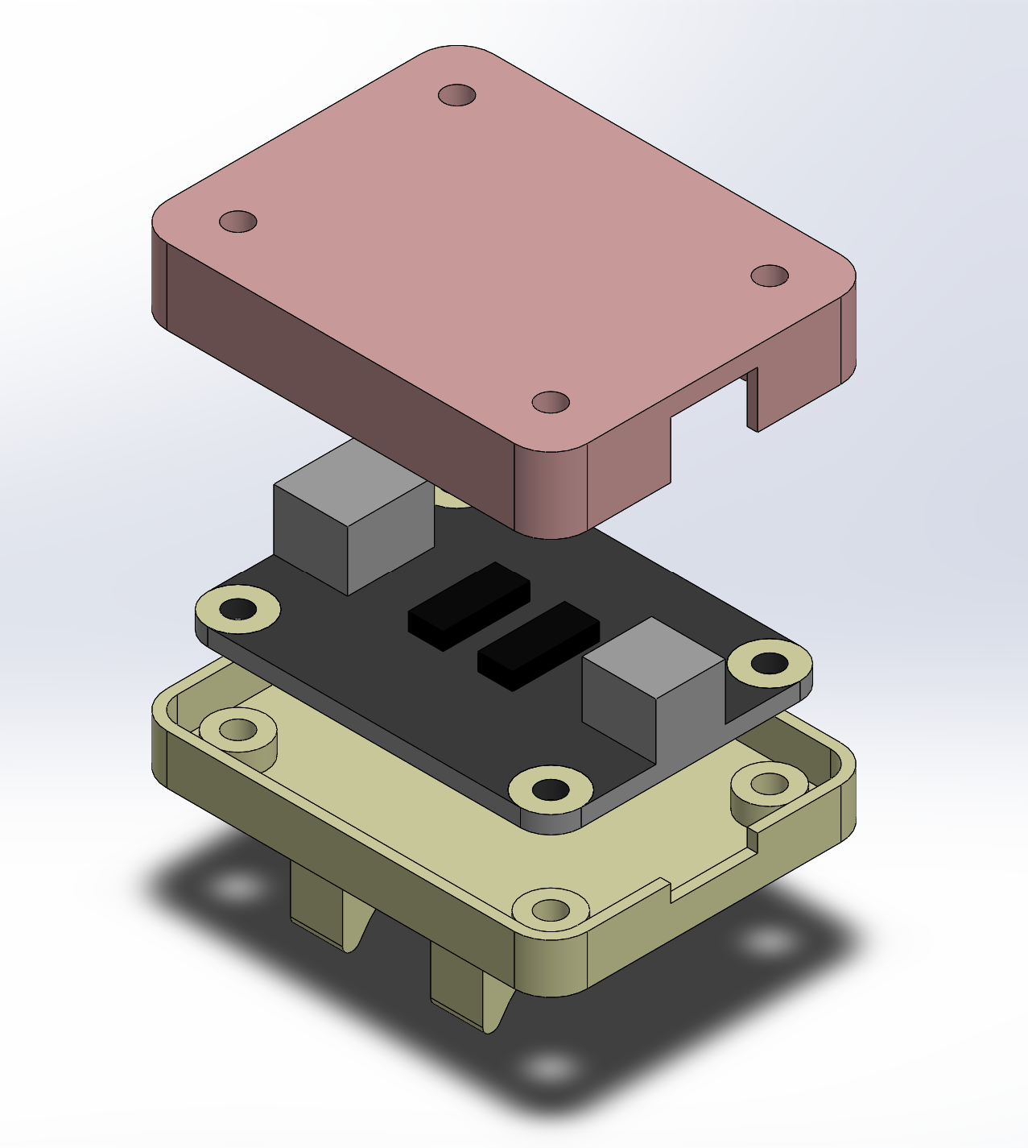
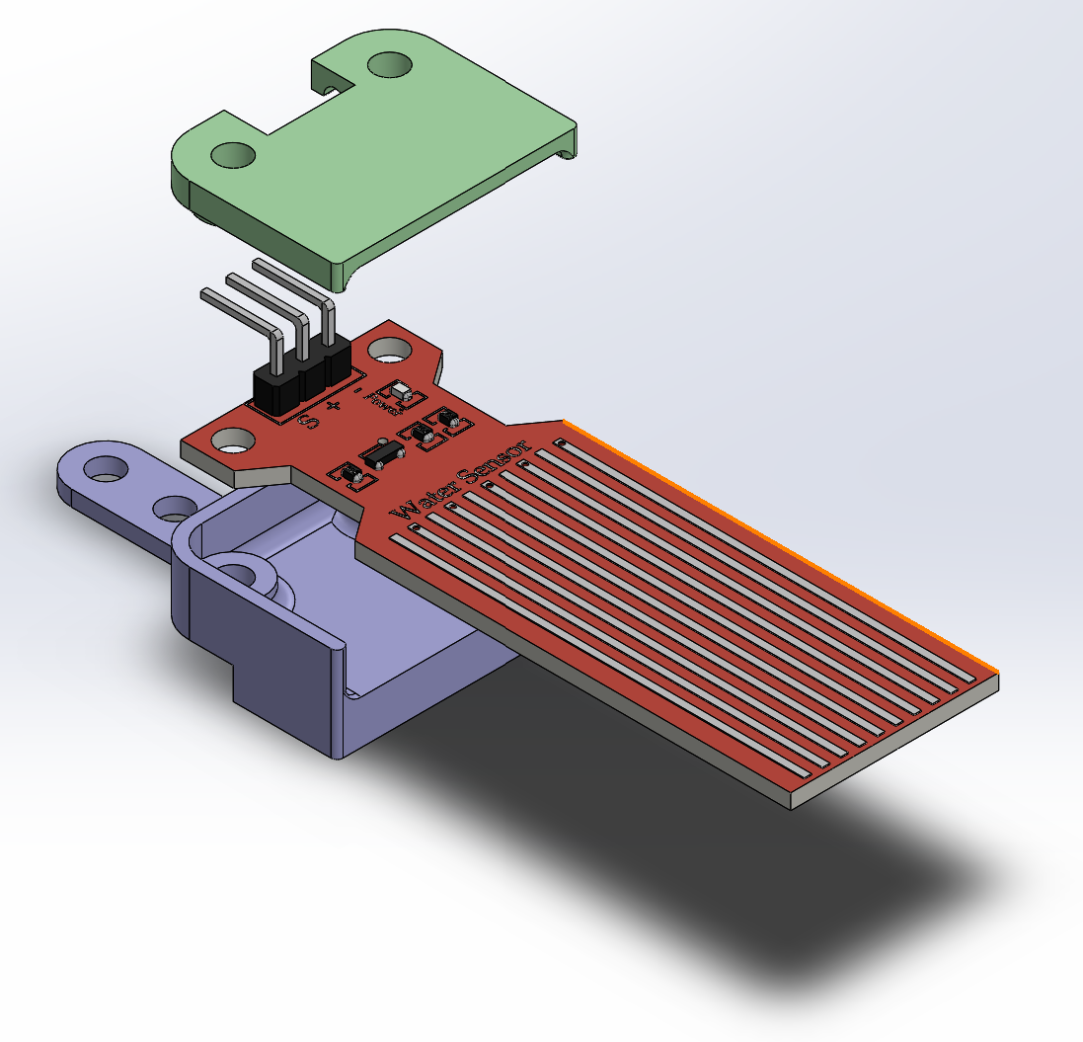
Component CAD Drawings
Isometric view of EduBox Educational Kit
Exploded view of TDS
Sensor Mount / Cover
Exploded view of Water Level Sensor Mount / Cover

Slide 9
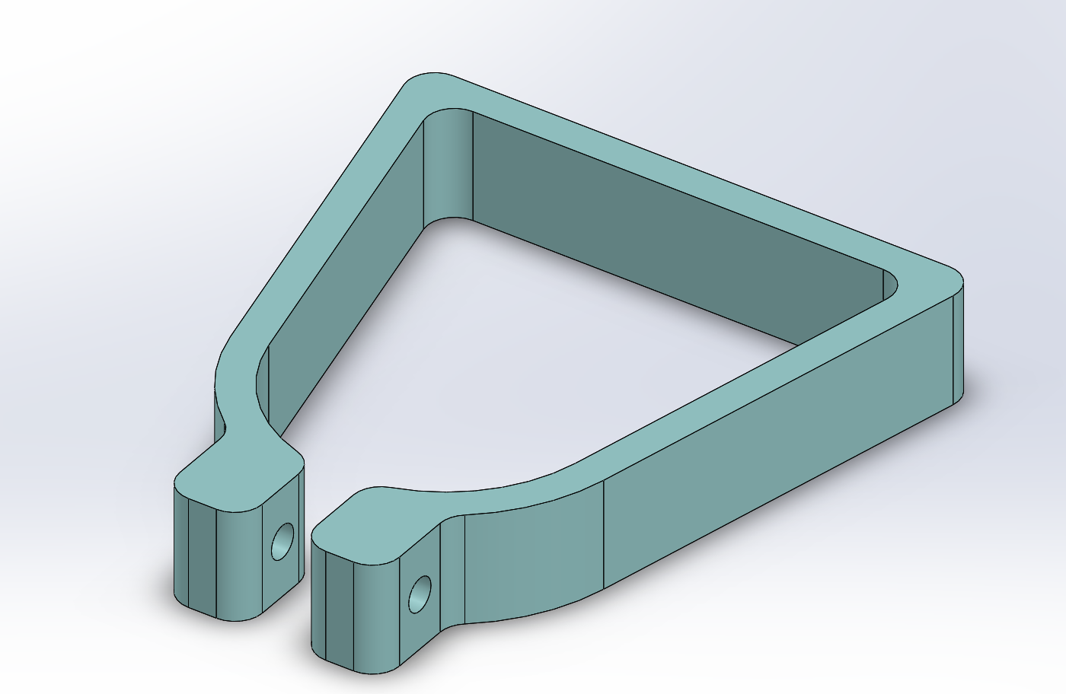
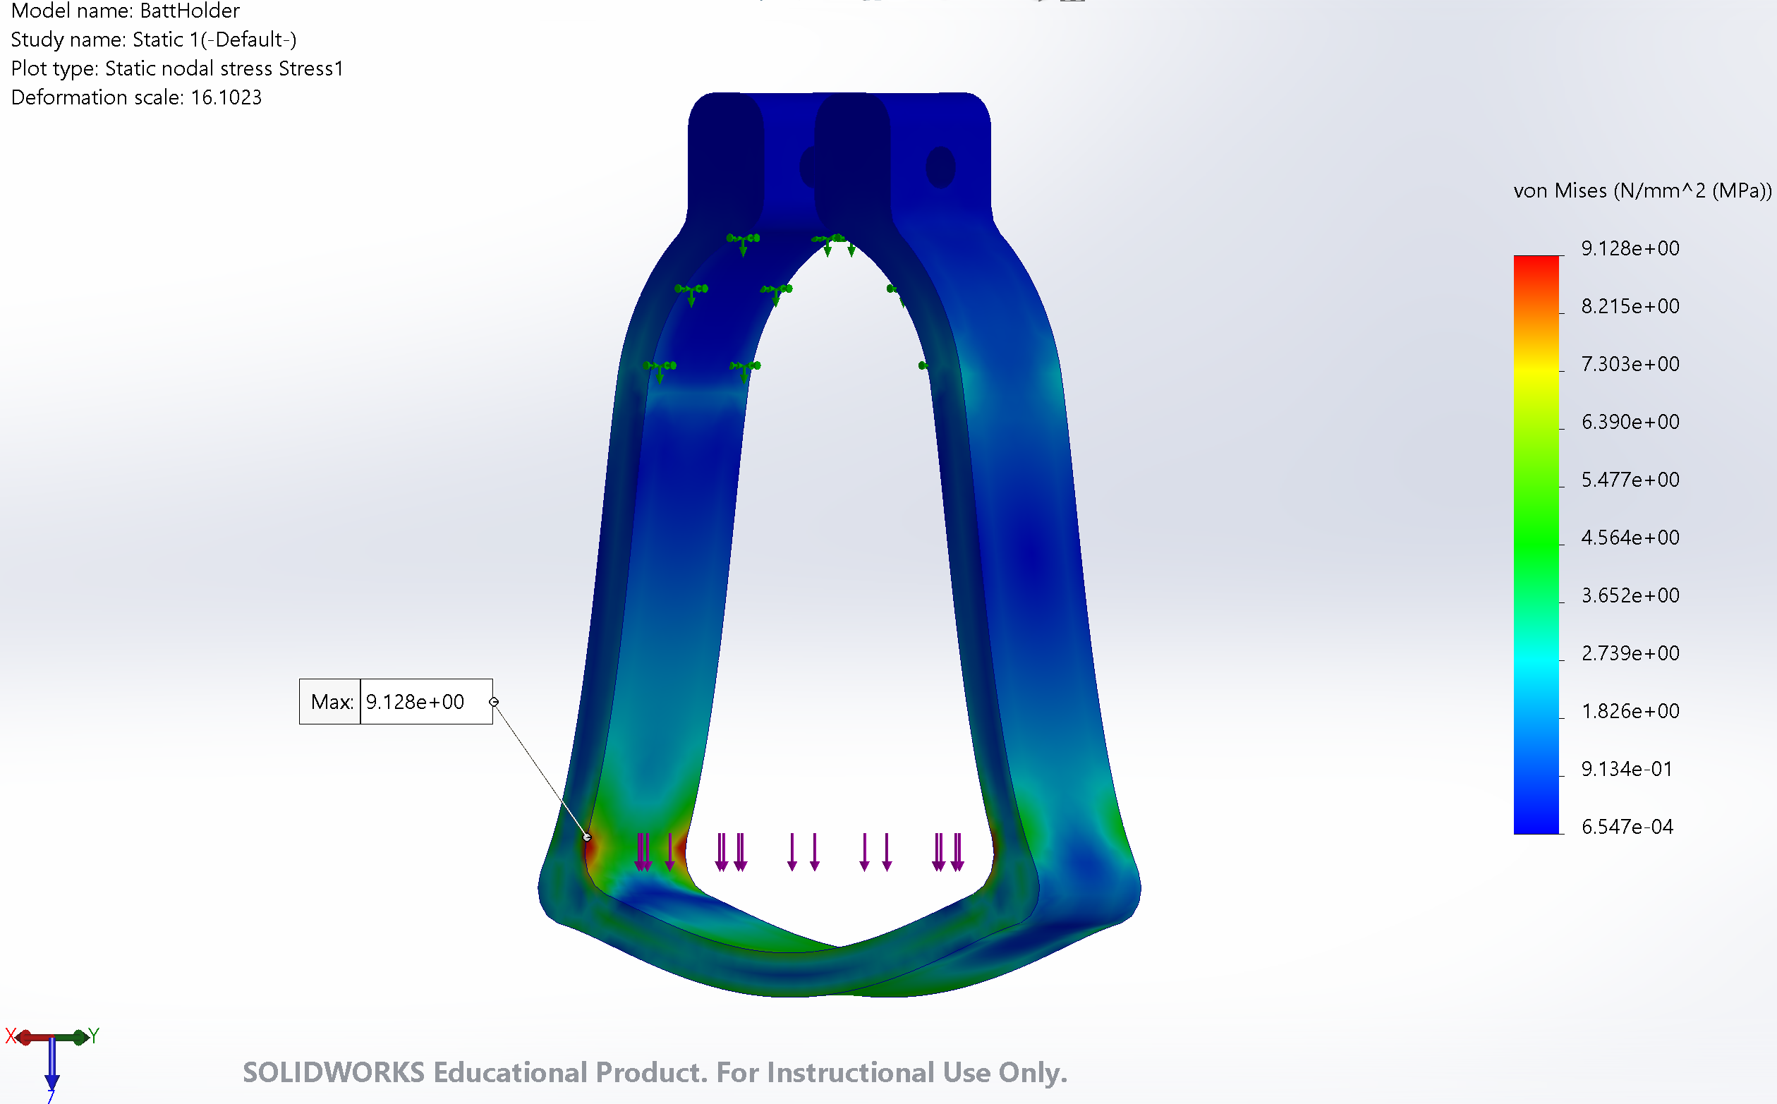
Battery Mount CAD (Structural Component)
Max Stress on Component: 9.128 MPa
PLA UTS: ~30 MPa (Empirical Testing)
FoS ~3 (2x Aerospace standard 1.5 FoS)

Slide 10
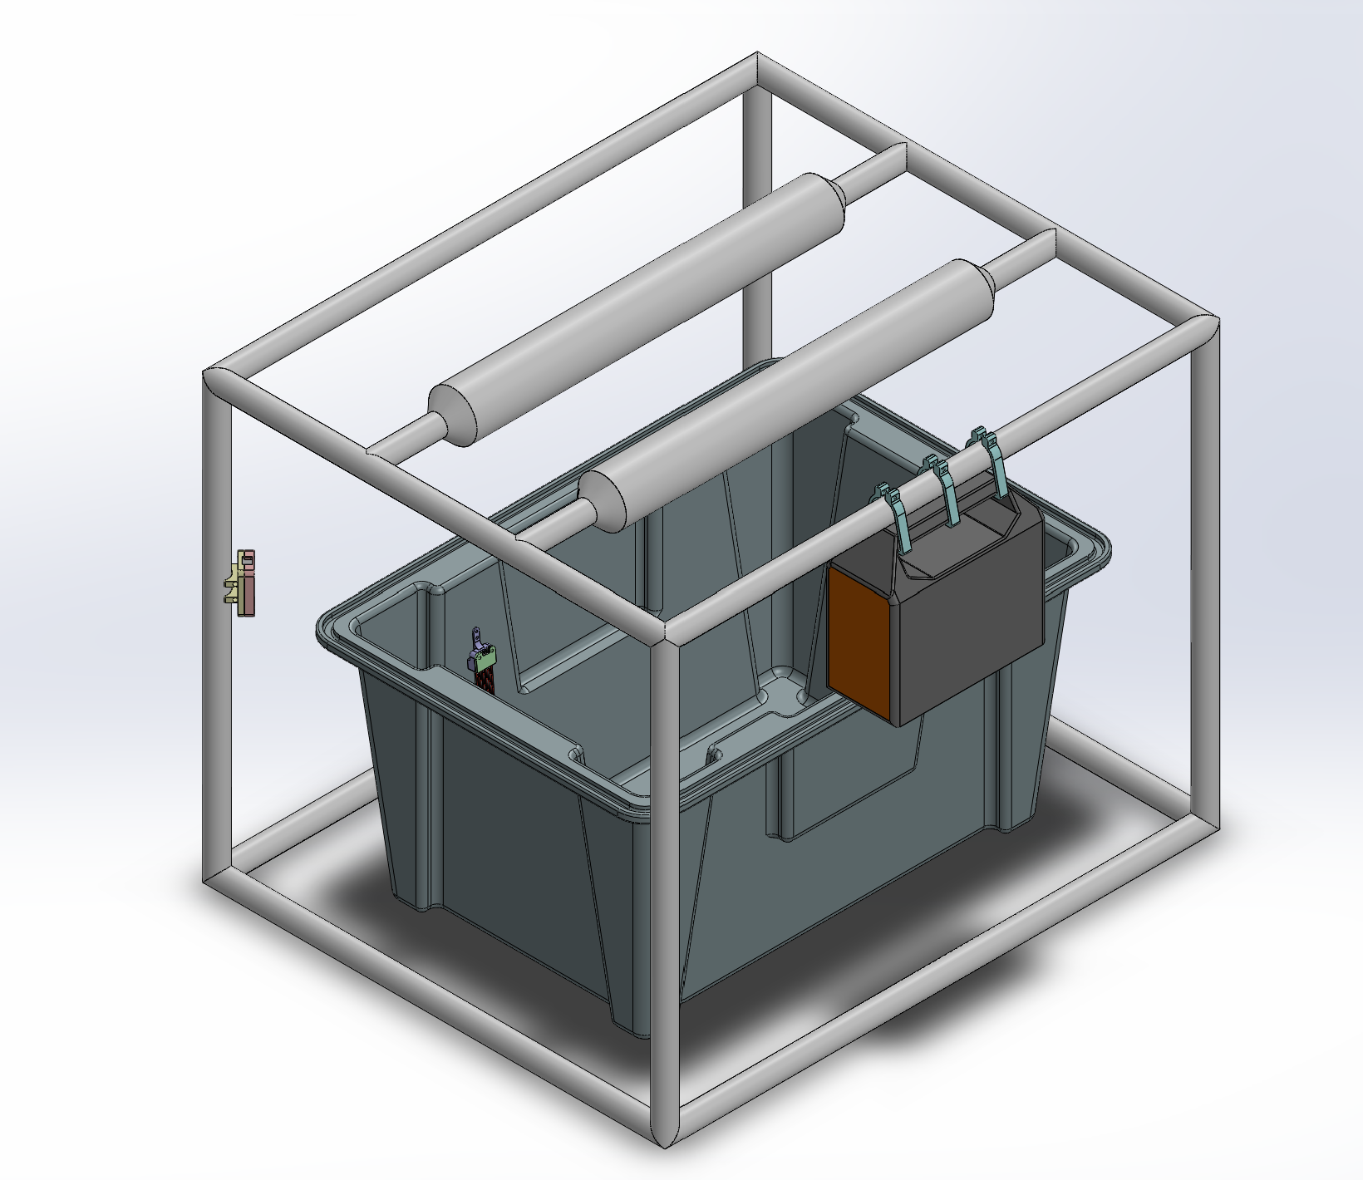
Overall System CAD Drawing
1
TDS Sensor
Measures water particulates in PPM; used to determine nutrient levels in water.
3
AIMTOM Battery
Provides power w/o the need for outside electricity.
2
Water Level Sensor
Measures water depth in reservoir; ensures that there is enough water for pump to function.

Slide 11
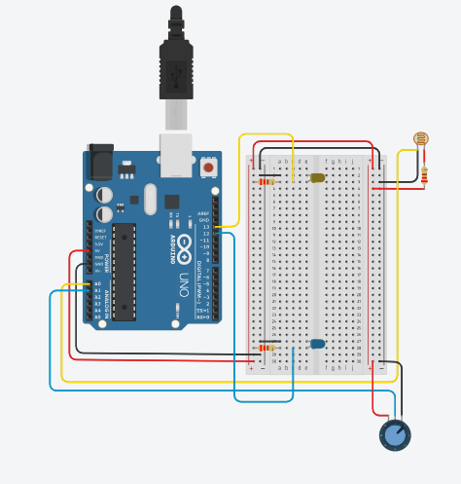
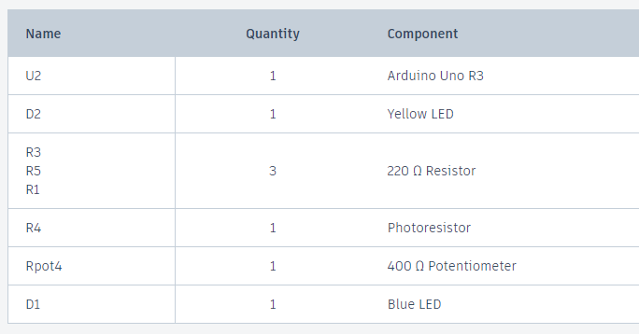
Wiring Diagram

Slide 12
System Diagram
INPUTS
Water temperature
Water particulates
Water depth
PROCESSES
Sensors read input data
Arduino code converts sensor data to useful values
Arduino sends values to Node-Red via WiFi
OUTPUTS
Node-Red displays hydroponics system values via easy-to-read user interface (UI)

Slide 13
Pseudo Code
Initialization:
-Initialize system
-Calibrate sensors (if required)
-Start sensor readings loop
Sensor Monitoring Loop:
-While system is operational:
-Read TDS sensor data
-Read temperature sensor data
-Read water level sensor data
-Transmit sensor data to central processing unit
-Delay (to control reading frequency)

Slide 14
Pseudo Code continued
Sensor Data Processing:
-Receive sensor data and publish to Node-red
Check sensor values against preset thresholds:
- TDS threshold (water quality)
- Temperature threshold (environment control)
- Water level threshold (reservoir management)
Implement appropriate actions based on sensor data:
- Adjust nutrient levels if TDS is too high or low
- add warm or cool water based on temperature readings
- Control water pumps based on water level data
User Interface and Feedback:
-Display sensor data on Node-red user interface

Slide 15
Test Plan and Results
Sensor Initialization and Readings:
Objective: ensure sensor initialization correctly and provide accurate readings
Results: All sensors initialize upon system startup without errors And Sensor readings remain consistent and stable without significant fluctuations
Stakeholder Needs Addressed: Reliable sensor data to maintain optimal hydroponic conditions and ensure educational accuracy.

Slide 16
Test Plan and Results continued
Sensor Data Processing and Control Actions:
Objective: Validate system response to sensor data for controlling environmental parameters.
Results: System detects high TDS and temperature levels accurately and UI gauge adjusts colors accordingly.
Stakeholder Needs Addressed: Demonstrates system capability to maintain ideal growing conditions and teach students about automated control systems.

Slide 17
Test Plan and Results continued
User Interface and Feedback:
Objective: Ensure user interface provides clear sensor data and actionable feedback.
Results: Sensor readings (TDS, temperature, water level) are clearly displayed on the Node-red user interface in a user-friendly format.
Stakeholder Needs Addressed: Enhances user experience for students to engage with sensor data and learn about system operation.

Slide 18
Lessons Learned
Working as a team in an international project requires a smooth transition across time zones and communication hurdles. It's critical to have open lines of communication and recognize each person's areas of strength. Unity is essential for success despite differences in backgrounds.
Underestimating the workload associated with extensive sensor integration and coding. Having someone who understood Arduinos or having prior knowledge on Arduinos would have made the process much easier.

Slide 19
Conclusion
Able to work as a team to meet all stakeholder needs
Successfully created an operational system that has real time data on a dashboard
Amazing initiative to teach children important topics
A great learning experience for everyone
A successful international project

Slide 20
Q&A
Does anyone have any questions?

